Slide 1
Introduction to Differential Equations – Lecture 18
Fei Qi
fei.qi@du.edu
https://feiqimath.github.io

Slide 2
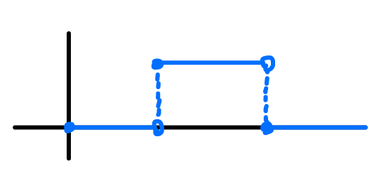
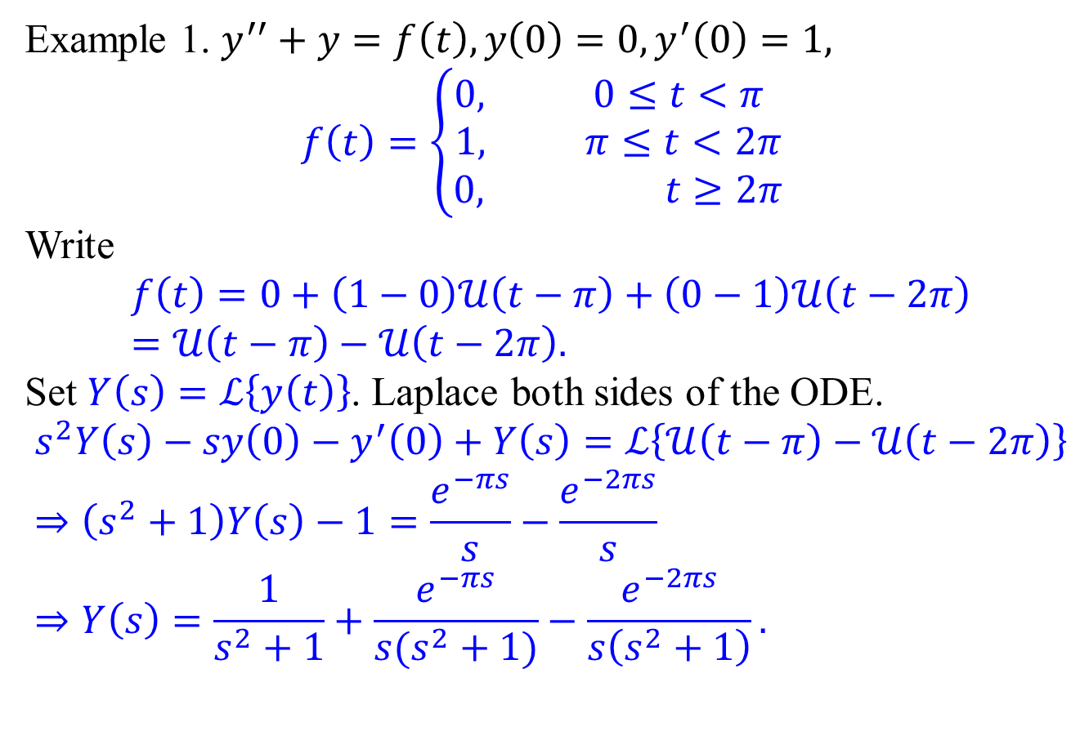
IVP with piecewise functions: More examples.
Example 1. $y^{′′}+y=f\left(t\right), y\left(0\right)=0, y^{′}\left(0\right)=1,$ $$f\left(t\right)=\left\{\begin{aligned}0, 0≤t<π \\ 1, π≤t<2π \\ &0, t≥2π \end{aligned}\right.$$
Write
$$f\left(t\right)=0+\left(1−0\right)𝒰\left(t−π\right)+\left(0−1\right)𝒰\left(t−2π\right) \\ =𝒰\left(t−π\right)−𝒰\left(t−2π\right).$$
Set $Y\left(s\right)=ℒ\left\{y\left(t\right)\right\}$. Laplace both sides of the ODE. $$s^{2}Y\left(s\right)−sy\left(0\right)−y^{′}\left(0\right)+Y\left(s\right)=ℒ\left\{𝒰\left(t−π\right)−𝒰\left(t−2π\right)\right\} \\ ⇒\left(s^{2}+1\right)Y\left(s\right)−1=\frac{e^{−πs}}{s}−\frac{e^{−2πs}}{s} \\ ⇒Y\left(s\right)=\frac{1}{s^{2}+1}+\frac{e^{−πs}}{s(s^{2}+1)}−\frac{e^{−2πs}}{s\left(s^{2}+1\right)}.$$

Slide 3
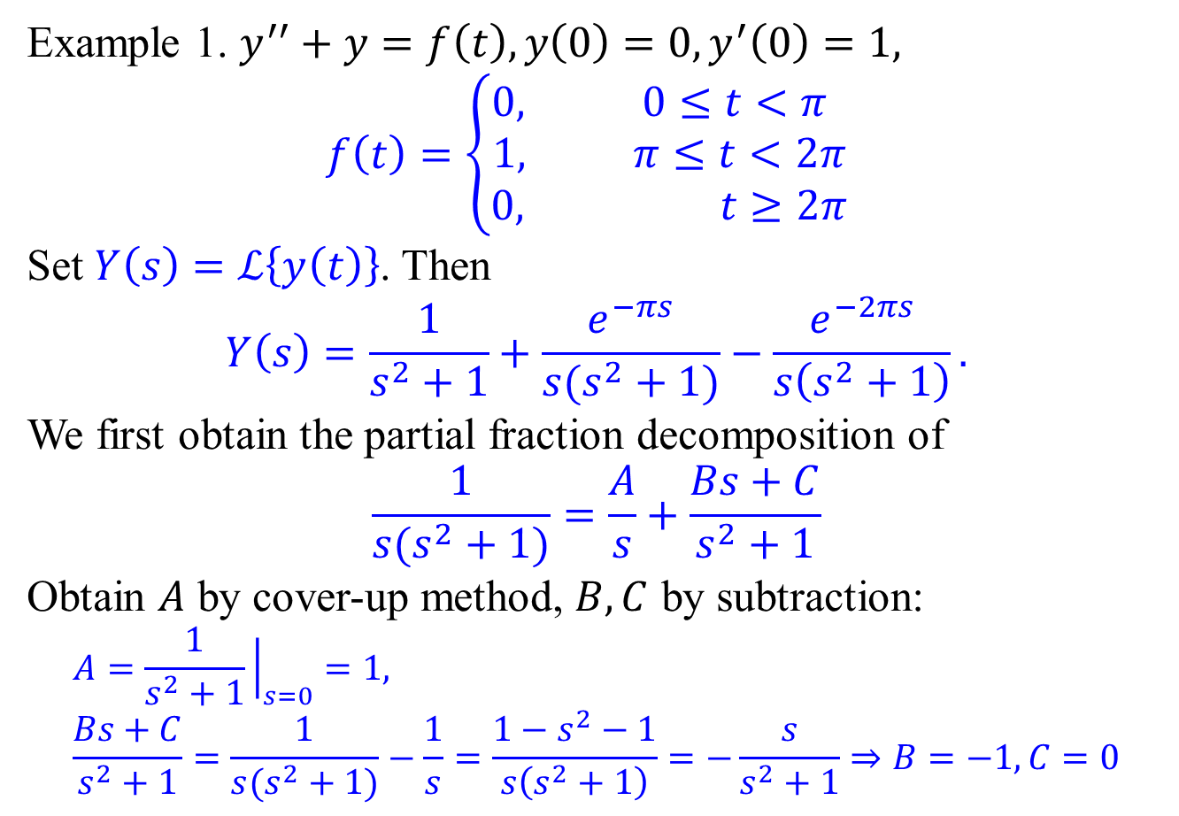
IVP with piecewise functions: More examples.
Example 1. $y^{′′}+y=f\left(t\right), y\left(0\right)=0, y^{′}\left(0\right)=1,$ $$f\left(t\right)=\left\{\begin{aligned}0, 0≤t<π \\ 1, π≤t<2π \\ &0, t≥2π \end{aligned}\right.$$
Set $Y\left(s\right)=ℒ\left\{y\left(t\right)\right\}$. Then
$$Y\left(s\right)=\frac{1}{s^{2}+1}+\frac{e^{−πs}}{s(s^{2}+1)}−\frac{e^{−2πs}}{s\left(s^{2}+1\right)}.$$
We first obtain the partial fraction decomposition of
$$\frac{1}{s(s^{2}+1)}=\frac{A}{s}+\frac{Bs+C}{s^{2}+1}$$
Obtain $A$ by cover-up method, $B,C$ by subtraction:
$$A=\frac{1}{s^{2}+1}{\left.​\right|}_{s=0}=1, \\ \frac{Bs+C}{s^{2}+1}=\frac{1}{s(s^{2}+1)}−\frac{1}{s}=\frac{1−s^{2}−1}{s\left(s^{2}+1\right)}=−\frac{s}{s^{2}+1}⇒B=−1,C=0$$

Slide 4
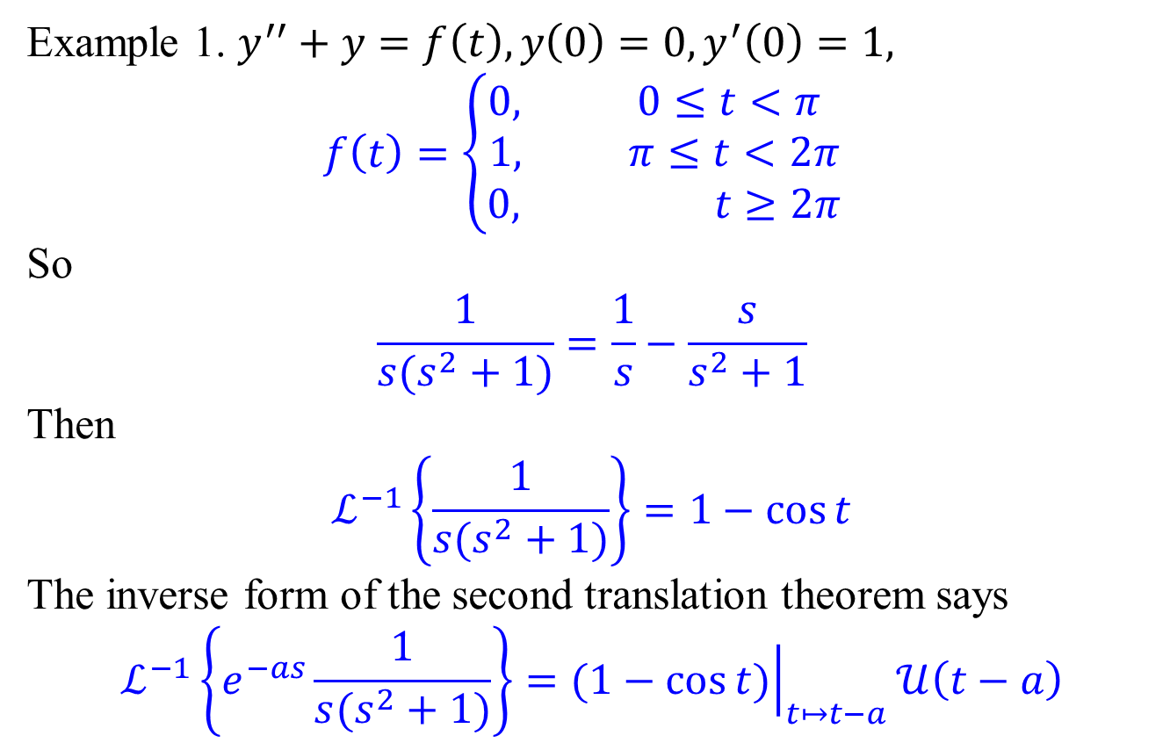
IVP with piecewise functions: More examples.
Example 1. $y^{′′}+y=f\left(t\right), y\left(0\right)=0, y^{′}\left(0\right)=1,$ $$f\left(t\right)=\left\{\begin{aligned}0, 0≤t<π \\ 1, π≤t<2π \\ &0, t≥2π \end{aligned}\right.$$
So
$$\frac{1}{s(s^{2}+1)}=\frac{1}{s}−\frac{s}{s^{2}+1}$$
Then
$$ℒ^{−1}\left\{\frac{1}{s(s^{2}+1)}\right\}=1−\cos{t}$$
The inverse form of the second translation theorem says
$$ℒ^{−1}\left\{e^{−as}\frac{1}{s(s^{2}+1)}\right\}={\left.(1−\cos{t)}\right|}_{t↦t−a}𝒰\left(t−a\right)$$

Slide 5
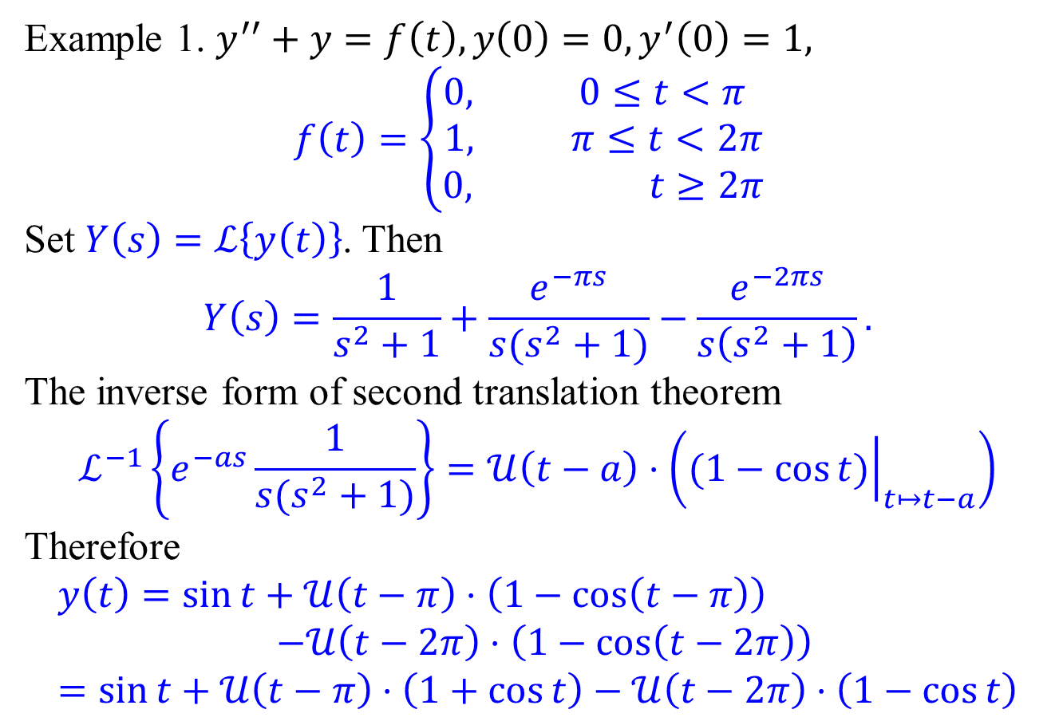
IVP with piecewise functions: More examples.
Example 1. $y^{′′}+y=f\left(t\right), y\left(0\right)=0, y^{′}\left(0\right)=1,$ $$f\left(t\right)=\left\{\begin{aligned}0, 0≤t<π \\ 1, π≤t<2π \\ &0, t≥2π \end{aligned}\right.$$
Set $Y\left(s\right)=ℒ\left\{y\left(t\right)\right\}$. Then
$$Y\left(s\right)=\frac{1}{s^{2}+1}+\frac{e^{−πs}}{s(s^{2}+1)}−\frac{e^{−2πs}}{s\left(s^{2}+1\right)}.$$
The inverse form of second translation theorem
$$ℒ^{−1}\left\{e^{−as}\frac{1}{s(s^{2}+1)}\right\}=𝒰\left(t−a\right)⋅\left({\left.(1−\cos{t)}\right|}_{t↦t−a}\right)$$
Therefore
$$y\left(t\right)=\sin{t}+𝒰\left(t−π\right)⋅\left(1−\cos\left(t−π\right)\right) \\ −𝒰\left(t−2π\right)⋅\left(1−\cos\left(t−2π\right)\right) \\ =\sin{t}+𝒰\left(t−π\right)⋅\left(1+\cos{t}\right)−𝒰\left(t−2π\right)⋅\left(1−\cos{t}\right)$$

Slide 6
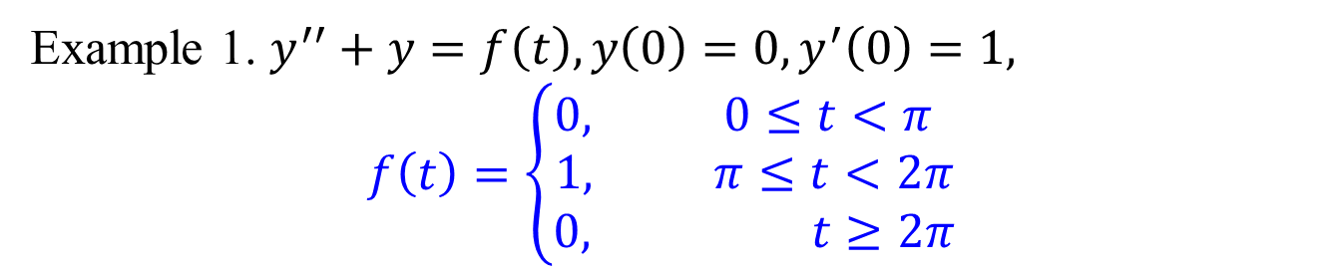
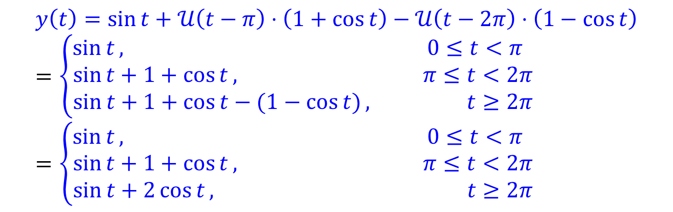
IVP with piecewise functions: More examples.
Example 1. $y^{′′}+y=f\left(t\right), y\left(0\right)=0, y^{′}\left(0\right)=1,$ $$f\left(t\right)=\left\{\begin{aligned}0, 0≤t<π \\ 1, π≤t<2π \\ &0, t≥2π \end{aligned}\right.$$
$$y\left(t\right)=\sin{t}+𝒰\left(t−π\right)⋅\left(1+\cos{t}\right)−𝒰\left(t−2π\right)⋅\left(1−\cos{t}\right) \\ =\left\{\begin{aligned}\sin{t}, 0≤t<π \\ \sin{t+1+\cos{t}, } π≤t<2π \\ &\sin{t+1+\cos{t}−(1−\cos{t)}}, t≥2π \end{aligned}\right. \\ =\left\{\begin{aligned}\sin{t}, 0≤t<π \\ \sin{t+1+\cos{t}, } π≤t<2π \\ &\sin{t+2\cos{t}}, t≥2π \end{aligned}\right.$$

Slide 7
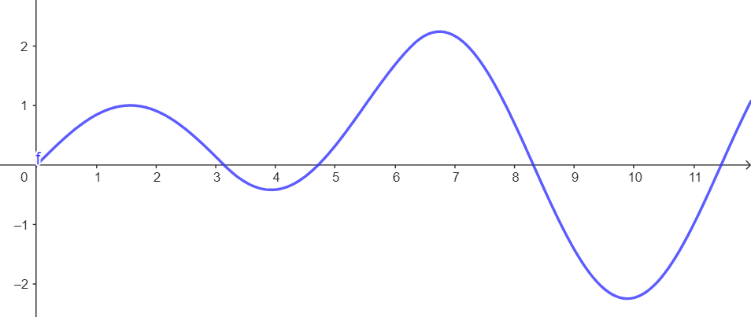


IVP with piecewise functions: More examples.
Example 1. $y^{′′}+y=f\left(t\right), y\left(0\right)=0, y^{′}\left(0\right)=1,$ $$f\left(t\right)=\left\{\begin{aligned}0, 0≤t<π \\ 1, π≤t<2π \\ &0, t≥2π \end{aligned}\right.$$
(Automatically continuous)
$$y\left(t\right)=\sin{t}+𝒰\left(t−π\right)⋅\left(1+\cos{t}\right)−𝒰\left(t−2π\right)⋅\left(1−\cos{t}\right) \\ =\left\{\begin{aligned}\sin{t}, 0≤t<π \\ \sin{t+1+\cos{t}, } π≤t<2π \\ &\sin{t+1+\cos{t}−(1−\cos{t)}}, t≥2π \end{aligned}\right. \\ =\left\{\begin{aligned}\sin{t}, 0≤t<π \\ \sin{t+1+\cos{t}, }π≤t<2π \\ &\sin{t+2\cos{t}}, t≥2π \end{aligned}\right.$$

Slide 8
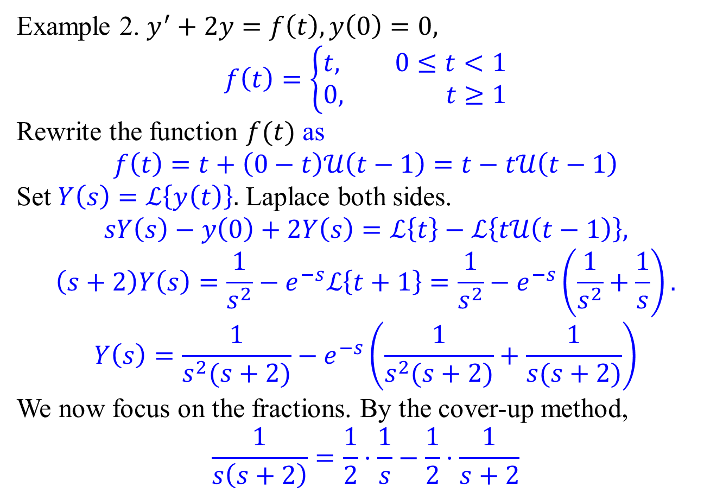
IVP with piecewise functions: More examples.
Example 2. $y^{′}+2y=f\left(t\right), y\left(0\right)=0,$ $$f\left(t\right)=\left\{\begin{aligned}t, 0≤t<1 \\ &0, t≥1\end{aligned}\right.$$
Rewrite the function $f(t)$ as
$$f\left(t\right)=t+\left(0−t\right)𝒰\left(t−1\right)=t−t𝒰\left(t−1\right)$$
Set $Y\left(s\right)=ℒ\left\{y\left(t\right)\right\}.$ Laplace both sides.
$$sY\left(s\right)−y\left(0\right)+2Y\left(s\right)=ℒ\left\{t\right\}−ℒ\left\{t𝒰\left(t−1\right)\right\},$$
$$\left(s+2\right)Y\left(s\right)=\frac{1}{s^{2}}−e^{−s}ℒ\left\{t+1\right\}=\frac{1}{s^{2}}−e^{−s}\left(\frac{1}{s^{2}}+\frac{1}{s}\right).$$
$$Y\left(s\right)=\frac{1}{s^{2}(s+2)}−e^{−s}\left(\frac{1}{s^{2}(s+2)}+\frac{1}{s(s+2)}\right)$$ We now focus on the fractions. By the cover-up method,
$$\frac{1}{s\left(s+2\right)}=\frac{1}{2}⋅\frac{1}{s}−\frac{1}{2}⋅\frac{1}{s+2}$$

Slide 9
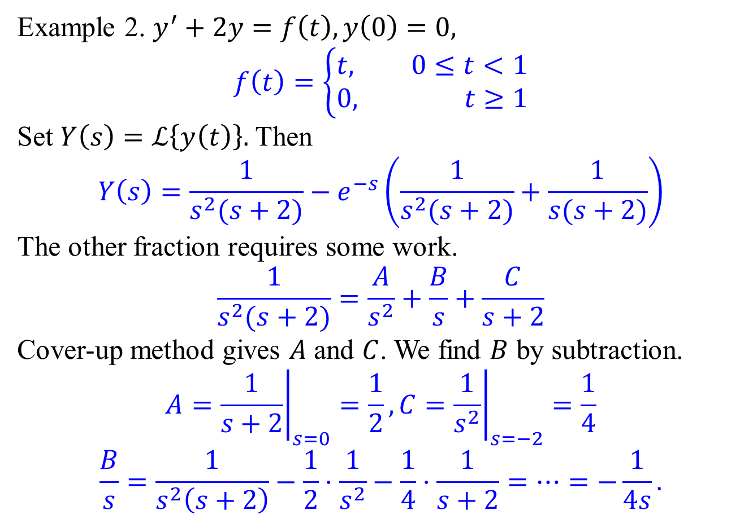
IVP with piecewise functions: More examples.
Example 2. $y^{′}+2y=f\left(t\right), y\left(0\right)=0,$ $$f\left(t\right)=\left\{\begin{aligned}t, 0≤t<1 \\ &0, t≥1\end{aligned}\right.$$
Set $Y\left(s\right)=ℒ\left\{y\left(t\right)\right\}.$ Then
$$Y\left(s\right)=\frac{1}{s^{2}(s+2)}−e^{−s}\left(\frac{1}{s^{2}(s+2)}+\frac{1}{s(s+2)}\right)$$ The other fraction requires some work.
$$\frac{1}{s^{2}(s+2)}=\frac{A}{s^{2}}+\frac{B}{s}+\frac{C}{s+2}$$
Cover-up method gives $A$ and $C$. We find $B$ by subtraction.
$$A={\left.\frac{1}{s+2}\right|}_{s=0}=\frac{1}{2}, C={\left.\frac{1}{s^{2}}\right|}_{s=−2}=\frac{1}{4}$$
$$\frac{B}{s}=\frac{1}{s^{2}\left(s+2\right)}−\frac{1}{2}⋅\frac{1}{s^{2}}−\frac{1}{4}⋅\frac{1}{s+2}=⋯=−\frac{1}{4s}.$$

Slide 10
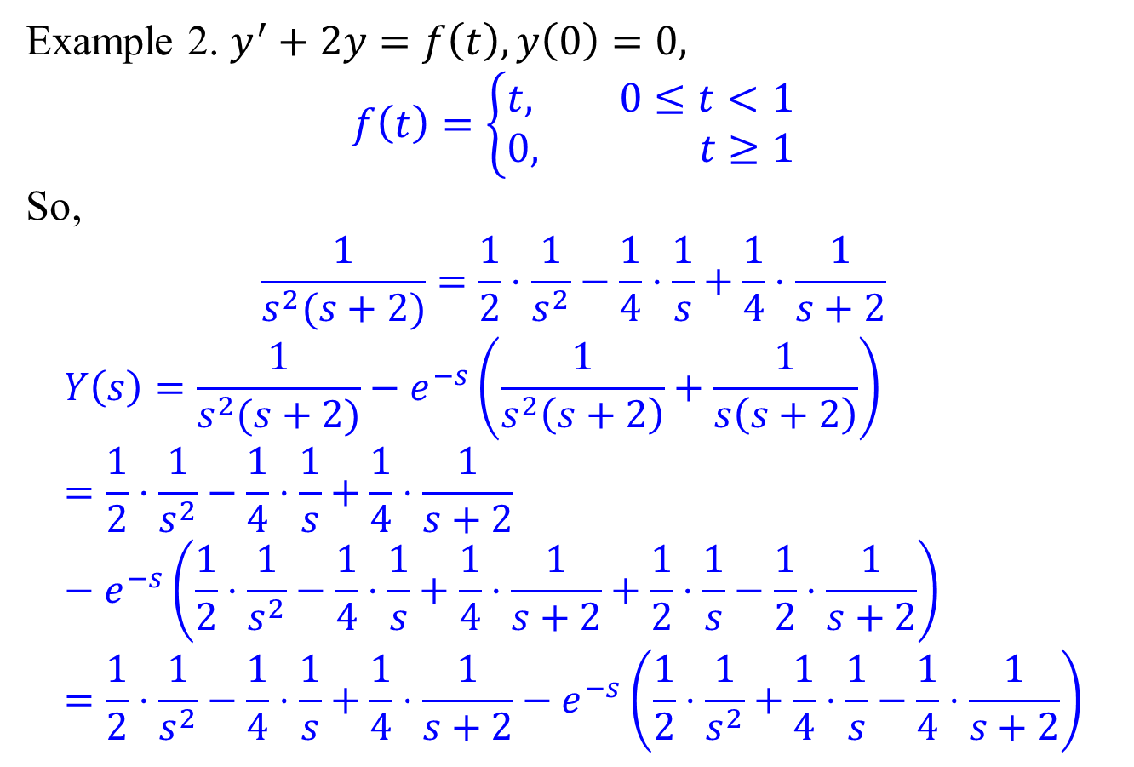
IVP with piecewise functions: More examples.
Example 2. $y^{′}+2y=f\left(t\right), y\left(0\right)=0,$ $$f\left(t\right)=\left\{\begin{aligned}t, 0≤t<1 \\ &0, t≥1\end{aligned}\right.$$
So,
$$\frac{1}{s^{2}(s+2)}=\frac{1}{2}⋅\frac{1}{s^{2}}−\frac{1}{4}⋅\frac{1}{s}+\frac{1}{4}⋅\frac{1}{s+2}$$
$$Y\left(s\right)=\frac{1}{s^{2}(s+2)}−e^{−s}\left(\frac{1}{s^{2}\left(s+2\right)}+\frac{1}{s\left(s+2\right)}\right)=\frac{1}{2}⋅\frac{1}{s^{2}}−\frac{1}{4}⋅\frac{1}{s}+\frac{1}{4}⋅\frac{1}{s+2}−e^{−s}\left(\frac{1}{2}⋅\frac{1}{s^{2}}−\frac{1}{4}⋅\frac{1}{s}+\frac{1}{4}⋅\frac{1}{s+2}+\frac{1}{2}⋅\frac{1}{s}−\frac{1}{2}⋅\frac{1}{s+2}\right) \\ =\frac{1}{2}⋅\frac{1}{s^{2}}−\frac{1}{4}⋅\frac{1}{s}+\frac{1}{4}⋅\frac{1}{s+2}−e^{−s}\left(\frac{1}{2}⋅\frac{1}{s^{2}}+\frac{1}{4}⋅\frac{1}{s}−\frac{1}{4}⋅\frac{1}{s+2}\right)$$

Slide 11
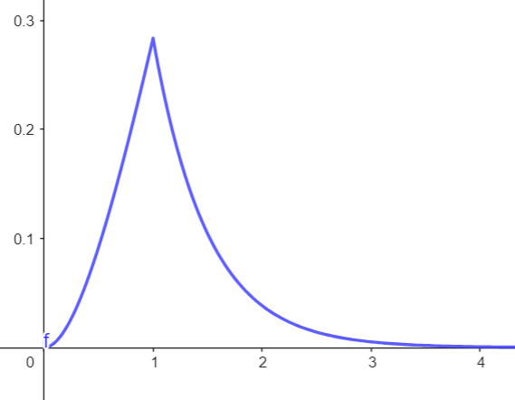
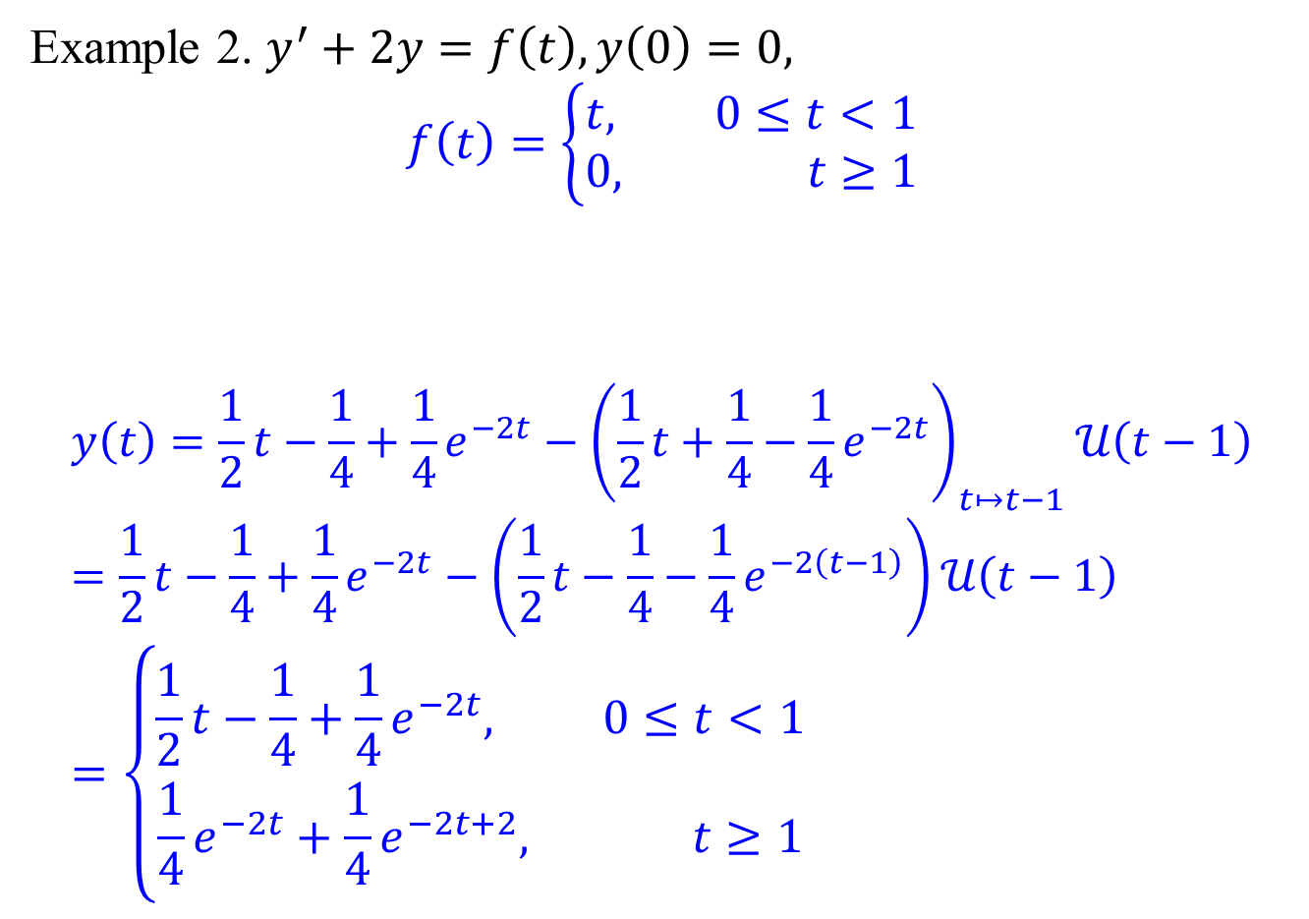
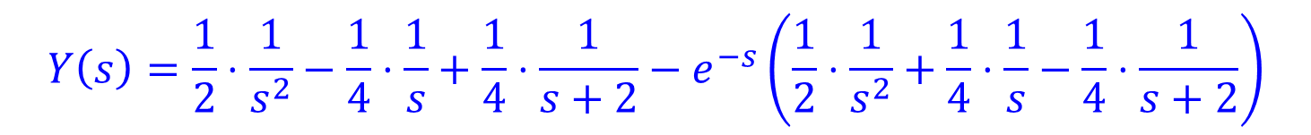
IVP with piecewise functions: More examples.
Example 2. $y^{′}+2y=f\left(t\right), y\left(0\right)=0,$ $$f\left(t\right)=\left\{\begin{aligned}t, 0≤t<1 \\ &0, t≥1\end{aligned}\right.$$
$$y\left(t\right)=\frac{1}{2}t−\frac{1}{4}+\frac{1}{4}e^{−2t}−{\left(\frac{1}{2}t+\frac{1}{4}−\frac{1}{4}e^{−2t}\right)}_{t↦t−1}𝒰\left(t−1\right) \\ =\frac{1}{2}t−\frac{1}{4}+\frac{1}{4}e^{−2t}−\left(\frac{1}{2}t−\frac{1}{4}−\frac{1}{4}e^{−2\left(t−1\right)}\right)𝒰\left(t−1\right) \\ =\left\{\begin{aligned}\frac{1}{2}t−\frac{1}{4}+\frac{1}{4}e^{−2t}, 0≤t<1 \\ &\frac{1}{4}e^{−2t}+\frac{1}{4}e^{−2t+2}, t≥1\end{aligned}\right.$$
$$Y\left(s\right)=\frac{1}{2}⋅\frac{1}{s^{2}}−\frac{1}{4}⋅\frac{1}{s}+\frac{1}{4}⋅\frac{1}{s+2}−e^{−s}\left(\frac{1}{2}⋅\frac{1}{s^{2}}+\frac{1}{4}⋅\frac{1}{s}−\frac{1}{4}⋅\frac{1}{s+2}\right)$$

Slide 12
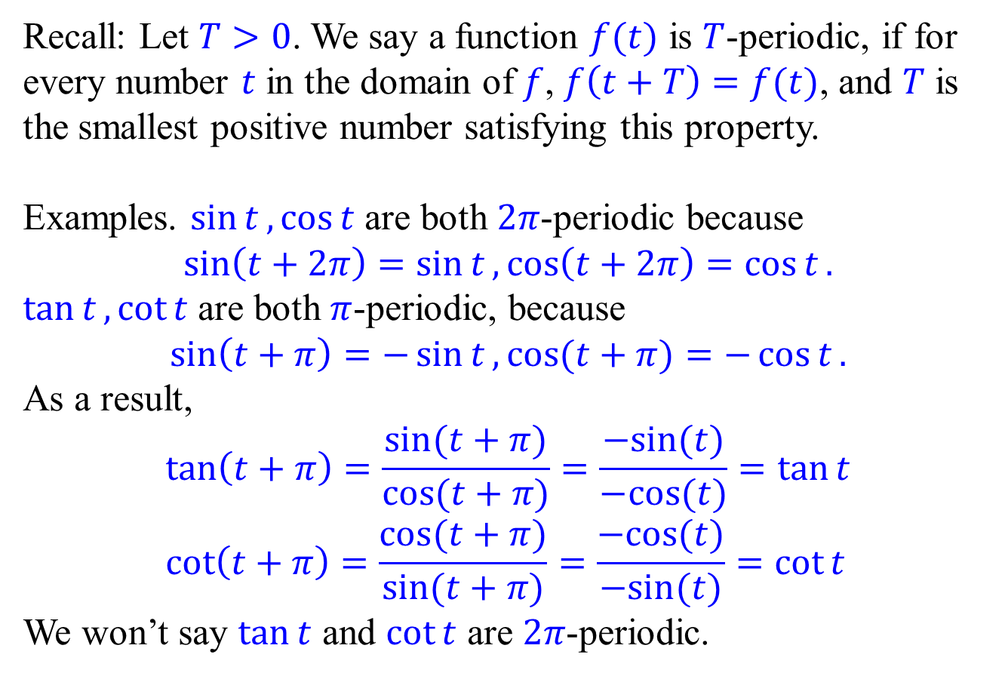
Laplace transform of periodic functions
Recall: Let $T>0$. We say a function $f(t)$ is $T$-periodic, if for every number $t$ in the domain of $f$, $f\left(t+T\right)=f(t)$, and $T$ is the smallest positive number satisfying this property.
Examples. $\sin{t},\cos{t}$ are both $2π$-periodic because
$$\sin\left(t+2π\right)=\sin{t},\cos\left(t+2π\right)=\cos{t}.$$
$\tan{t},\cot{t}$ are both $π$-periodic, because
$$\sin\left(t+π\right)=−\sin{t},\cos{(t+π)}=−\cos{t}.$$
As a result,
$$\tan\left(t+π\right)=\frac{sin⁡(t+π)}{\cos{(t+π)}}=\frac{−sin⁡(t)}{−cos{(t)}}=\tan{t} \\ \cot\left(t+π\right)=\frac{cos(t+π)}{\sin{(t+π)}}=\frac{−cos⁡(t)}{−sin{(t)}}=\cot{t}$$
We won’t say $\tan{t}$ and $\cot{t}$ are $2π$-periodic.

Slide 13
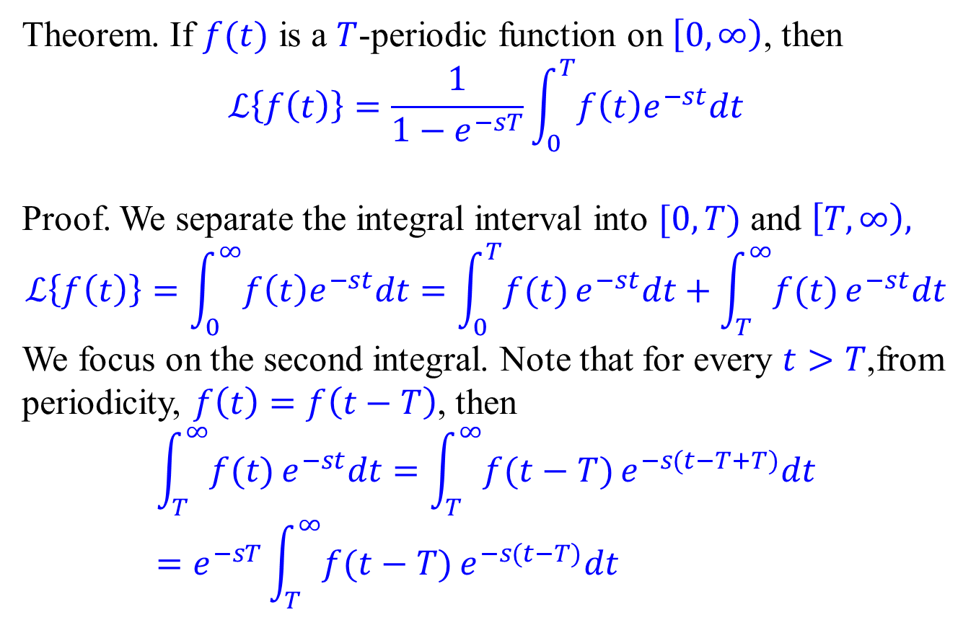
Laplace transform of periodic functions
Theorem. If $f(t)$ is a $T$-periodic function on $\left[0,∞\right)$, then
$$ℒ\left\{f\left(t\right)\right\}=\frac{1}{1−e^{−sT}}\int_{0}^{T}{f\left(t\right)e^{−st}dt}$$
Proof. We separate the integral interval into $[0,T)$ and $\left[T,∞\right),$
$$ℒ\left\{f\left(t\right)\right\}=\int_{0}^{∞}{f\left(t\right)e^{−st}dt}=\int_{0}^{T}{f(t)}e^{−st}dt+\int_{T}^{∞}{f(t)}e^{−st}dt$$
We focus on the second integral. Note that for every $t>T$,from periodicity, $f\left(t\right)=f\left(t−T\right)$, then
$$\int_{T}^{∞}{f(t)}e^{−st}dt=\int_{T}^{∞}{f(t−T)}e^{−s(t−T+T)}dt \\ =e^{−sT}\int_{T}^{∞}{f(t−T)}e^{−s(t−T)}dt$$

Slide 14
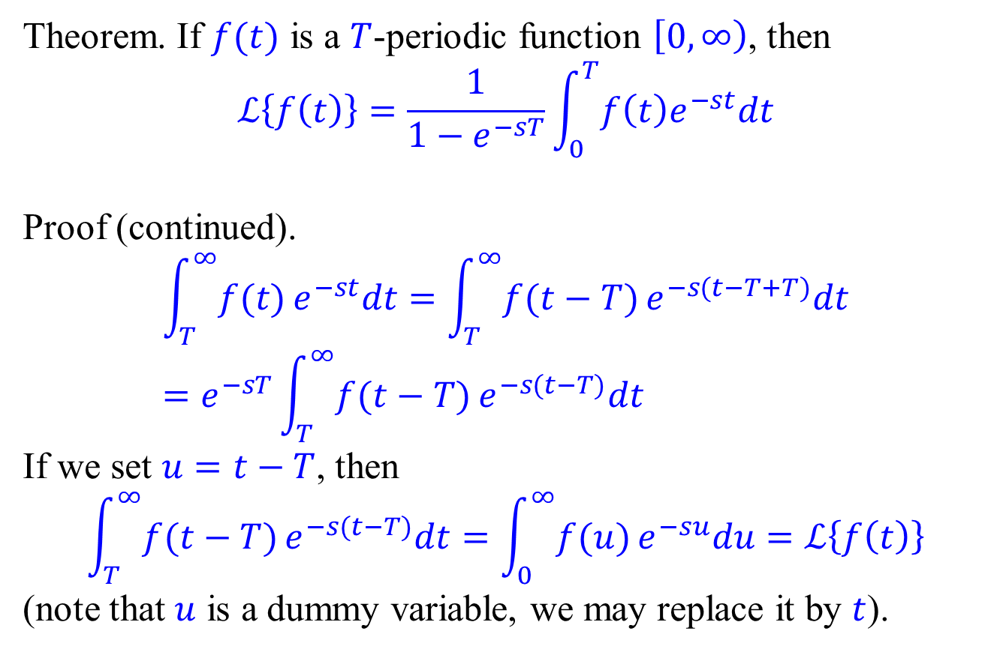
Laplace transform of periodic functions
Theorem. If $f(t)$ is a $T$-periodic function $\left[0,∞\right)$, then
$$ℒ\left\{f\left(t\right)\right\}=\frac{1}{1−e^{−sT}}\int_{0}^{T}{f\left(t\right)e^{−st}dt}$$
Proof (continued).
$$\int_{T}^{∞}{f(t)}e^{−st}dt=\int_{T}^{∞}{f(t−T)}e^{−s(t−T+T)}dt \\ =e^{−sT}\int_{T}^{∞}{f(t−T)}e^{−s(t−T)}dt$$
If we set $u=t−T$, then
$$\int_{T}^{∞}{f(t−T)}e^{−s(t−T)}dt=\int_{0}^{∞}{f(u)}e^{−su}du=ℒ\left\{f\left(t\right)\right\}$$
(note that $u$ is a dummy variable, we may replace it by $t$).

Slide 15
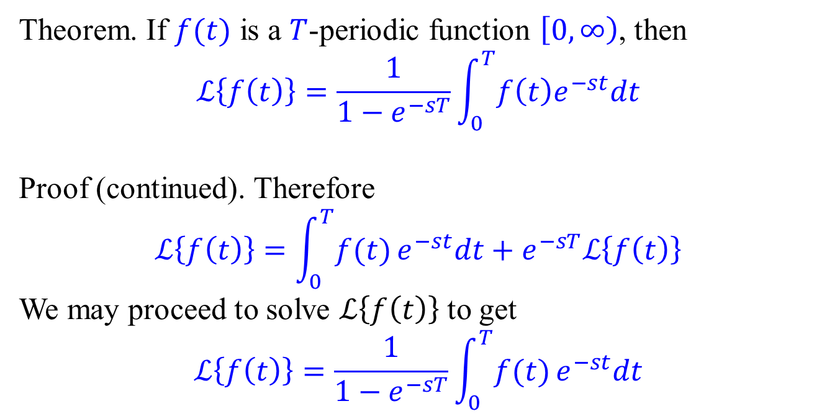
Laplace transform of periodic functions
Theorem. If $f(t)$ is a $T$-periodic function $\left[0,∞\right)$, then
$$ℒ\left\{f\left(t\right)\right\}=\frac{1}{1−e^{−sT}}\int_{0}^{T}{f\left(t\right)e^{−st}dt}$$
Proof (continued). Therefore
$$ℒ\left\{f\left(t\right)\right\}=\int_{0}^{T}{f(t)}e^{−st}dt+e^{−sT}ℒ\left\{f\left(t\right)\right\}$$
We may proceed to solve $ℒ\left\{f\left(t\right)\right\}$ to get
$$ℒ\left\{f\left(t\right)\right\}=\frac{1}{1−e^{−sT}}\int_{0}^{T}{f(t)}e^{−st}dt$$

Slide 16

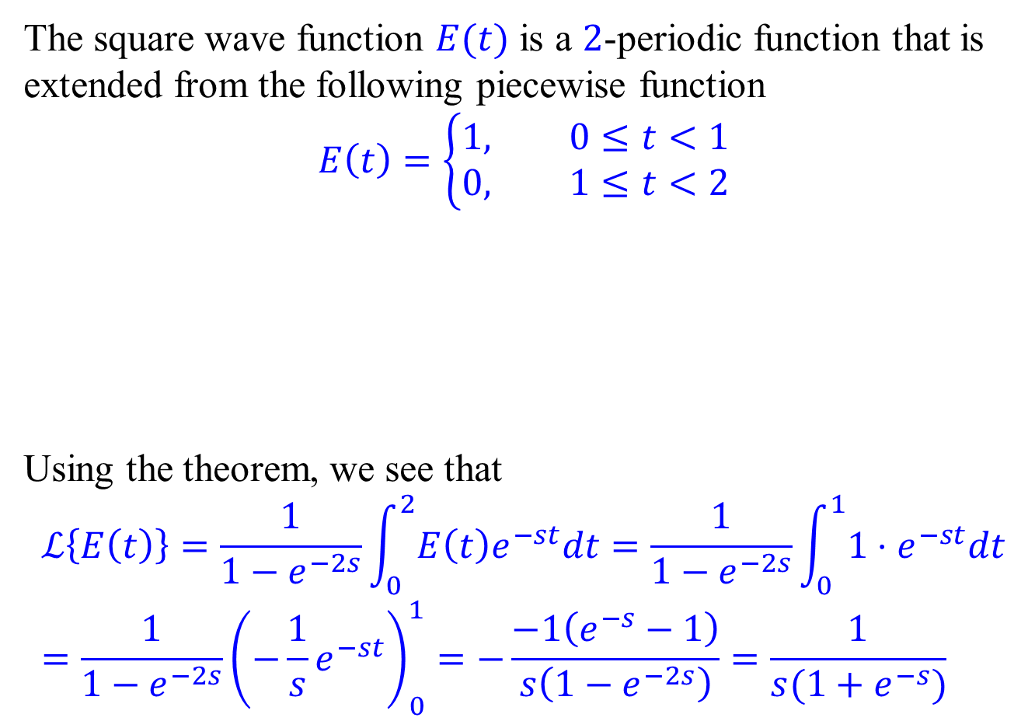






Laplace transform of the square wave function
The square wave function $E(t)$ is a 2-periodic function that is extended from the following piecewise function
$$E\left(t\right)=\left\{\begin{aligned}1, 0≤t<1 \\ &0, 1≤t<2\end{aligned}\right.$$
Using the theorem, we see that
$$ℒ\left\{E\left(t\right)\right\}=\frac{1}{1−e^{−2s}}\int_{0}^{2}{E\left(t\right)e^{−st}dt}=\frac{1}{1−e^{−2s}}\int_{0}^{1}{1⋅e^{−st}dt} \\ =\frac{1}{1−e^{−2s}}{\left(−\frac{1}{s}e^{−st}\right)}_{0}^{1}=−\frac{−1\left(e^{−s}−1\right)}{s\left(1−e^{−2s}\right)}=\frac{1}{s(1+e^{−s})}$$
$$1$$
$$0$$
$$1$$
$$2$$
$$3$$
$$4$$
$$5$$

Slide 17
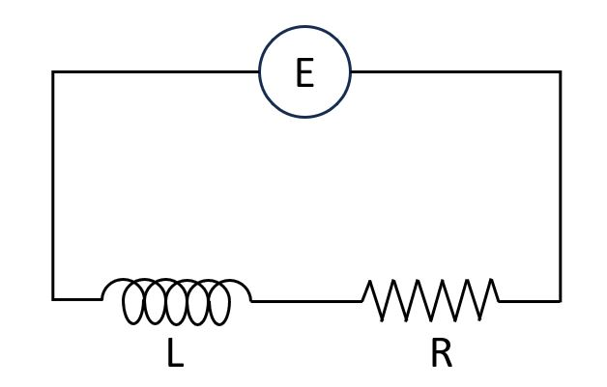
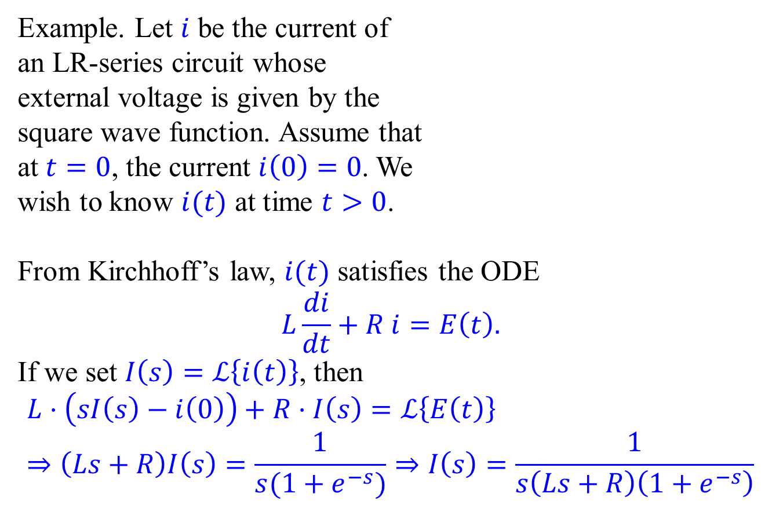
LR-series with square wave external voltage
Example. Let $i$ be the current of an LR-series circuit whose external voltage is given by the square wave function. Assume that at $t=0$, the current $i\left(0\right)=0$. We wish to know $i(t)$ at time $t>0$.
From Kirchhoff’s law, $i(t)$ satisfies the ODE
$$L\frac{di}{dt}+R i=E\left(t\right).$$
If we set $I\left(s\right)=ℒ\left\{i\left(t\right)\right\}$, then
$$L⋅\left(sI\left(s\right)−i\left(0\right)\right)+R⋅I\left(s\right)=ℒ\left\{E\left(t\right)\right\} \\ ⇒\left(Ls+R\right)I\left(s\right)=\frac{1}{s(1+e^{−s})}⇒I\left(s\right)=\frac{1}{s\left(Ls+R\right)\left(1+e^{−s}\right)}$$

Slide 18
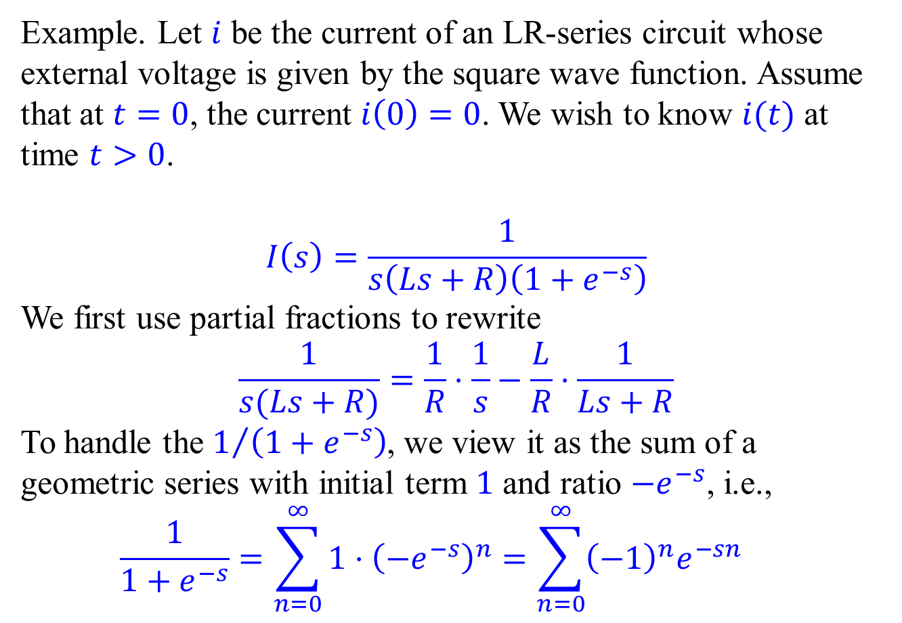
LR-series with square wave external voltage
Example. Let $i$ be the current of an LR-series circuit whose external voltage is given by the square wave function. Assume that at $t=0$, the current $i\left(0\right)=0$. We wish to know $i(t)$ at time $t>0$.
$$I\left(s\right)=\frac{1}{s\left(Ls+R\right)\left(1+e^{−s}\right)}$$
We first use partial fractions to rewrite
$$\frac{1}{s(Ls+R)}=\frac{1}{R}⋅\frac{1}{s}−\frac{L}{R}⋅\frac{1}{Ls+R}$$
To handle the $1/{\left(1+e^{−s}\right)}$, we view it as the sum of a geometric series with initial term 1 and ratio $−e^{−s}$, i.e.,
$$\frac{1}{1+e^{−s}}=\sum_{n=0}^{∞}{1⋅{\left(−e^{−s}\right)}^{n}}=\sum_{n=0}^{∞}{{\left(−1\right)}^{n}e^{−sn}}$$

Slide 19
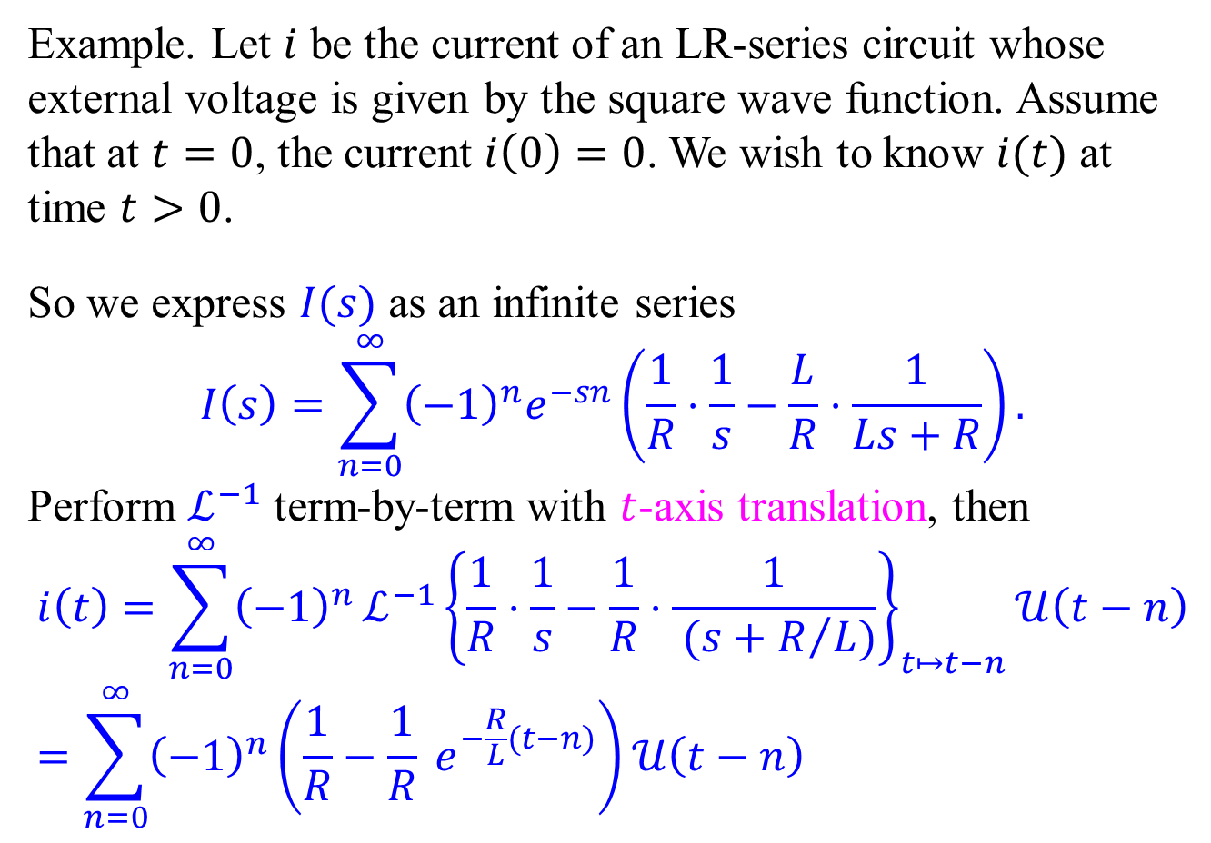
LR-series with square wave external voltage
Example. Let $i$ be the current of an LR-series circuit whose external voltage is given by the square wave function. Assume that at $t=0$, the current $i\left(0\right)=0$. We wish to know $i(t)$ at time $t>0$.
So we express $I(s)$ as an infinite series
$$I\left(s\right)=\sum_{n=0}^{∞}{{\left(−1\right)}^{n}e^{−sn}}\left(\frac{1}{R}⋅\frac{1}{s}−\frac{L}{R}⋅\frac{1}{Ls+R}\right).$$
Perform $ℒ^{−1}$ term-by-term with $t$-axis translation, then
$$i\left(t\right)=\sum_{n=0}^{∞}{{\left(−1\right)}^{n}}ℒ^{−1}{\left\{\frac{1}{R}⋅\frac{1}{s}−\frac{1}{R}⋅\frac{1}{ (s+R/L)}\right\}}_{t↦t−n}𝒰\left(t−n\right) \\ =\sum_{n=0}^{∞}{{\left(−1\right)}^{n}}\left(\frac{1}{R}−\frac{1}{R} e^{−\frac{R}{L}(t−n)}\right)𝒰\left(t−n\right)$$

Slide 20
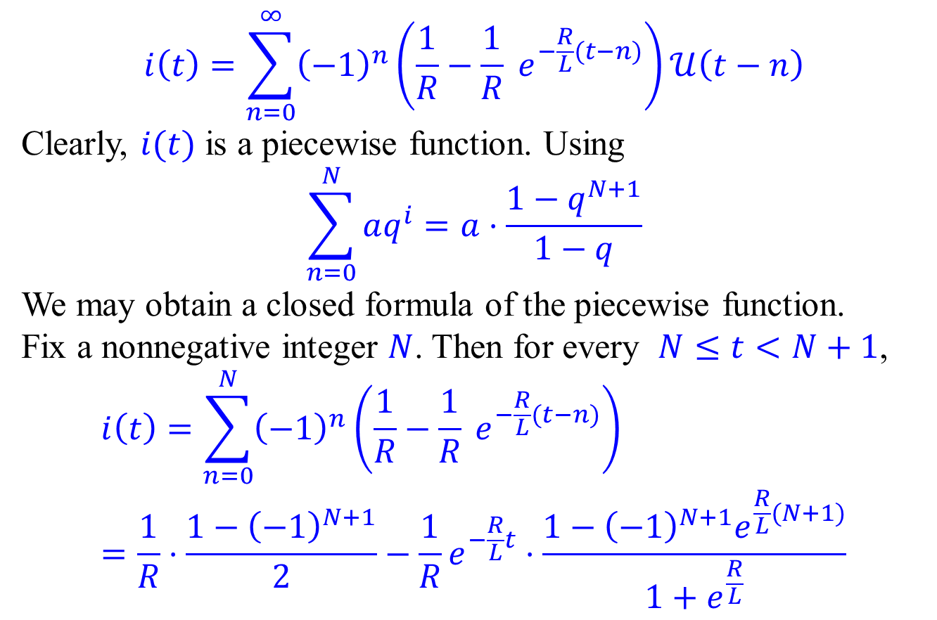
LR-series with square wave external voltage
$$i\left(t\right)=\sum_{n=0}^{∞}{{\left(−1\right)}^{n}}\left(\frac{1}{R}−\frac{1}{R} e^{−\frac{R}{L}(t−n)}\right)𝒰\left(t−n\right)$$
Clearly, $i(t)$ is a piecewise function. Using
$$\sum_{n=0}^{N}{aq^{i}}=a⋅\frac{1−q^{N+1}}{1−q}$$
We may obtain a closed formula of the piecewise function.
Fix a nonnegative integer $N$. Then for every $N≤t<N+1$,
$$i\left(t\right)=\sum_{n=0}^{N}{{\left(−1\right)}^{n}}\left(\frac{1}{R}−\frac{1}{R} e^{−\frac{R}{L}(t−n)}\right) \\ =\frac{1}{R}⋅\frac{1−{\left(−1\right)}^{N+1}}{2}−\frac{1}{R}e^{−\frac{R}{L}t}⋅\frac{1−{\left(−1\right)}^{N+1}e^{\frac{R}{L}(N+1)}}{1+e^{\frac{R}{L}}}$$
Satisfactory for this
course.
Won’t
require

